Slide 1
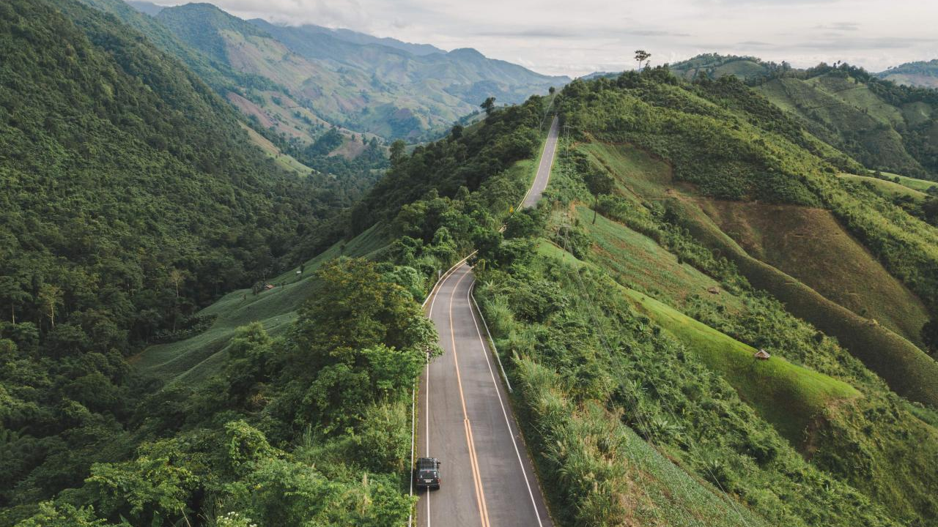



Government of Rajasthan
Forest Department
Forest Stack Open Innovation Challenge
Round 1 Submission
Wildfire AI Innovators

Slide 2
Agenda
My name is Aryan Singh, a BTech student from Mohanlal Sukhadia University, and I’ve been working
on this idea as part of the Forest Stack Open Innovation Challenge to help the Rajasthan Forest
Department (RFD) tackle wildfires in a smarter, more proactive way.
Imagine being a forest officer in Rajasthan, responsible for protecting 3.29 million hectares of forests
home to incred-ible biodiversity, local communities, and over 110.7 million tonnes of carbon stock that’s
crucial for fighting climate change. But every year, wildfires threaten to destroy all of that.The current
methods, like ground surveys and basic weather data, are slow and often can’t keep up with the vast,
remote areas you’re managing. It’s stressful, and you’re always one step Behind the fires. That’s
Where my project, Wildfire Prediction Using Satellite Imagery, comes into give RFD officers a
Powerful tool to stay Ahead of the flames.
The core idea is simple but impactful: I’m building an open-source platform that uses satellite imagery
from Sentinel-1 and Sentinel-2, combined with weather data, to predict wildfire risks in near real-time.
Here’s how it works. We pull in high-resolution imagery from these satellites—Sentinel-2 gives us
detailed visuals of vegetation health through things like NDVI (a measure of how green and dense
the forest is), while Sentinel-1 uses radar to assess moisture levels in the soil & plants, even through
clouds. Then, I add weather data—like temperature, humidity, and wind—from sources like ERA5 and
NOAA, because these factors play a huge role in fire risk.
To make sense of all this data, I use an AI model called CNN-LSTM,which I’ve built using PyTorch. The
CNN part analyzes the satellite images to spot patterns, like dry patches of forest that might be at risk,
while the LSTM part looks at how weather trends change over time to predict if conditions are getting
riskier. Together, they classify forest areas into High, Moderate, or No Risk zones, with predictions for
But the real magic happens when this data reaches the forest officers. I’ve designed a GIS dashboard
using Flask and Plotly that’s super easy to use—you don’t need to be a tech expert. It shows a map of
Rajasthan’s forests with color-coded zones: red for high risk, yellow for moderate, and green for safe.
With just a few clicks, officers can zoom into specific areas, see the risk level, and plan their next steps,
like sending teams to clear dry underbrush or setting up firebreaks. The whole system is open-source,
built with tools like Python, GDAL, and Xarray.

Slide 3
Agenda
Now, let’s talk about the benefits, because this is what really excites me. First, it saves time. Instead of
waiting for manual surveys to spot risks, RFD’s 285+ officers get real-time updates, so they can act
before a fire even starts. That means fewer forests lost, less harm to wildlife, and safer communities
nearby. Second, it protects Rajasthan’s 110.7 million tonnes of carbon stock—crucial for fighting
climate change—by stopping fires that release all that carbon into the atmosphere. Third, it’s cost-
effective. Since it uses existing satellite data and open-source tools, RFD doesn’t need to spend on
expensive equipment or software licenses.
But there’s more. This platform can also help with afforestation. By showing which areas are low-risk,
RFD can plan where to plant new trees, making their efforts more successful. It’s scalable too—if it
works in Rajasthan, we can adapt it for other states or even other forestry tasks, like monitoring
deforestation. During my Flipkart GRiD project, I built a system that cut inspection efforts by 40%,
and I’m aiming for a similar impact here—making RFD’s job easier and more effective.

Slide 4
Ideation Round
Template
Problem Statement
Wildfires threaten Rajasthan’s 3.29 million hectares of forests, risking biodiversity, 110.7 million+ tonnes of carbon stock, and local communities. RFD’s manual surveys and weather-based detection are slow and ineffective in remote areas, delaying prevention.
Solution Overview
Wildfire Prediction Using Satellite Imagery, is an open-source, AI-powered platform that predicts wildfire risks in Rajasthan’s forests using Sentinel-1/2 imagery and weather data (ERA5, NOAA), processed via GDAL/SNAP. A CNN-LSTM model (PyTorch) classifies areas as High, Moderate, or No Risk, visualized on a Flask/Plotly GIS dashboard. USPs: Hybrid AI for superior accuracy, open-source affordability, and a user-friendly dashboard requiring no GIS expertise.
Innovative Elements
My solution stands out with its hybrid CNN-LSTM model, combining spatial (Sentinel-1/2 imagery) and temporal (weather) analysis for precise wildfire prediction. Unlike traditional methods, it offers real-time risk mapping on an open-source, user-friendly GIS dashboard, requiring no GIS expertise—tailored for RFD’s 285+ officers to manage 3.29M hectares efficiently.
Impact Assessment
Stakeholders: RFD (285+ officers), local communities, environmental NGOs.
Type: Prevents wildfire losses, protects biodiversity, supports afforestation.
Scale: Covers 3.29M hectares, preserves 110.7M+ tonnes of carbon stock, enhances safety for people.
Dataset/ Hardware Requirements
Existing (per Appendix): Plantation records (site boundaries, species, dates), LULC data, rainfall, groundwater trends.
Additional: None required; uses public datasets (Sentinel-1/2 imagery, ERA5/NOAA weather).
Relies on existing satellite data (Sentinel-1/2); no new hardware needed for collection.
Processing: Cloud server (AWS/Google Cloud) for data processing and dashboard hosting.

Slide 5
Team Information & Expertise
Template
Team Name & Members:
Aryan Singh, B.Tech in Computer Science (Mohanlal Sukhadia University, CGPA 8.0), specializing in AI, Python, and satellite data processing.
Primary Contact
Aryan Singh, aryansingh4653@gmail.com, +91-8955424401
Institution/ Organization
Individual Applicant (Student)

Slide 6
Ideation Round
Exemplar for submission
Problem Statement
My project, Wildfire Prediction Using Satellite Imagery, uses Sentinel-1/2 data and AI (CNN-LSTM) to monitor vegetation density in near real-time, providing RFD with a GIS dashboard for timely, data-driven conservation decisions.
Solution Overview
The solution is a forest planning and monitoring application that integrates NASA/ISRO remote-sensing data (NDVI, Forest Cover, Canopy Density), open-source data (groundwater trends, depth, soil moisture, rainfall), and RFD’s data (plantation records, site info) into a unified digital interface for efficient management.
Broad Features Include
Creating BI tools Develop tools to calculate NDVI, Canopy Density, and Forest Cover using Sentinel-1/2 satellite imagery.
Automating Streamline ingestion of satellite imagery and open-source data (e.g., ERA5, NOAA).
Growth Analysis Identify healthy vs. underperforming plantation blocks using AI-driven insights
Mapping site-suitability Map areas for afforestation, considering environmental and soil conditions.
Intended Users
The satellite-based system predicts wildfires, reduces manual surveys, empowers forest management, and provides scalable technology.

Slide 7
Ideation Round
Exemplar for submission
Technology:
Leveraging satellite imagery and open-source data, wildfire prediction is powered by Airflow-driven data pipelines that fetch and process real-time forest health data, computing metrics like NDVI, canopy density, and forest cover. Results are stored in a PostgreSQL/PostGIS database for fast geospatial queries. A Vue/React-based dashboard visualizes color-coded vegetation indices, while basic user management enables RFD staff to log in, upload/view site info, and run NDVI analyses securely.
Innovative Elements
Satellite-driven monitoring: Real-time NDVI, canopy, density, and forest cover calculations to pinpoint high-risk zones.
User-Friendly Geo-Dashboard:Simplifies data visualization for staff with minimal training.
Data-driven resource allocation: Enhances wildfire prediction and management through actionable insights.
Impact Assessment
Enables timely, data-driven decisions by reducing manual surveys—digitally monitoring 3.29Mn hectares of land and 110.7Mn+ tonnes of carbon stock, while empowering 285+ forest officers.
Uses scalable tech components like satellite data pipelines, vegetation health analysis, and BI tools, which can be repurposed for other regions, agroforestry, or land management programs.

Slide 8
Ideation Round
Exemplar for submission
Dataset/ Hardware Requirements
RFD Datasets: Plantation records (site boundaries, species, planting dates) to map forest areas and assess fuel load.
Satellite Imagery: Sentinel-1/2 imagery for vegetation and moisture analysis,ERA5 climate data and NOAA weather data for temperature, humidity, and wind patterns,Land Use Land Cover (LULC) data, rainfall, and groundwater trends for contextual analysis..
LULC Data:
Cloud Infrastructure: AWS or Google Cloud server for data processing, model training, and dashboard hosting (e.g., EC2 instances with GPU support for AI training).
No Field Hardware: Relies entirely on existing satellite data, eliminating the need for additional sensors or on-ground equipment.
Local Setup: Optional laptops for RFD staff to access the web-based dashboard, requiring only internet connectivity.

Slide 9
Government of Rajasthan
Forest Department
Thank you

